Slide 1
Washer HCC Intro
John Conway
502-533-7688
10-4-2012

Slide 2
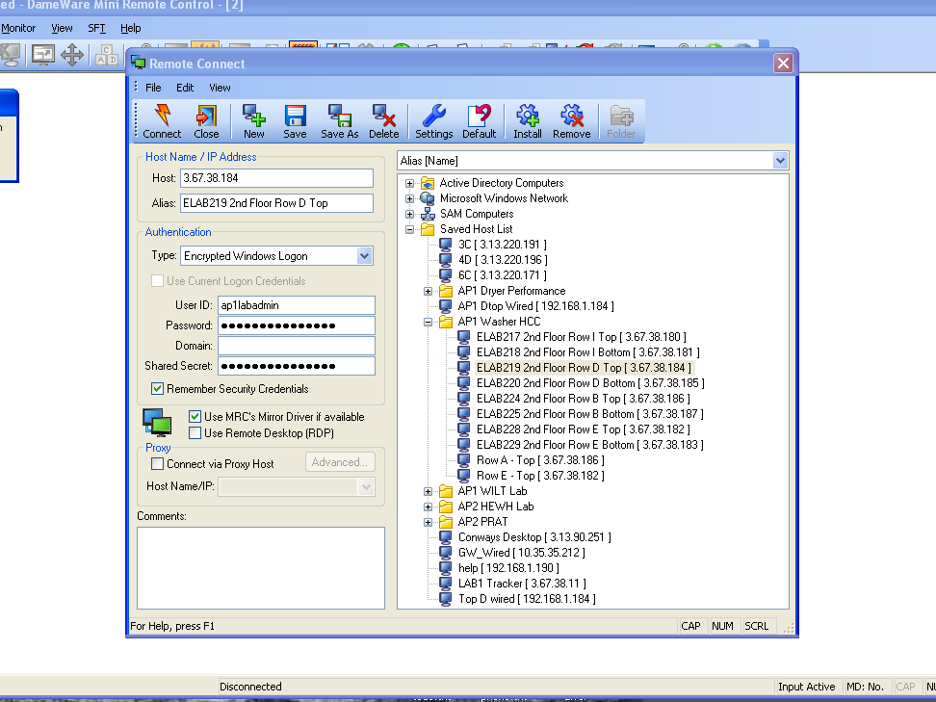
Use Dameware to connect to computer running the software
Connect -> Row D Top -> user ap1labadmin pw ap1heat4me

Slide 3
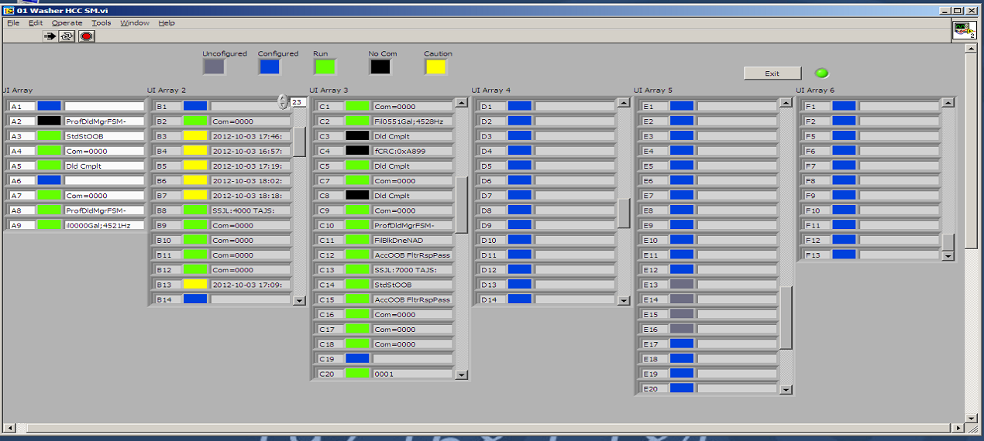
Gui shows current status of dryer test stations
Black, no communication for > 60 seconds
Yellow: detected MchStdby, MchPz, MchIdl
When one of these is seen, the indicator will tell the date and time and hold until it sees MchRn
Green: detected MchRn
Grey: At startup, serial converter not detected (check ICP7188E5 serial converter) This station is disabled until restart.

Slide 4
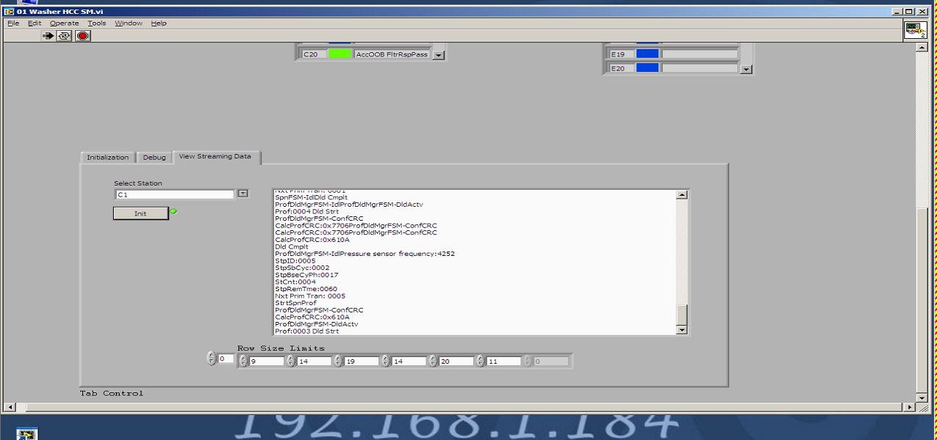
Adding a new unit
Use scroll bar to go down to View Streaming Data
Select Station
Click on Init to add a new unit. New units should show green ACK dot

Slide 5
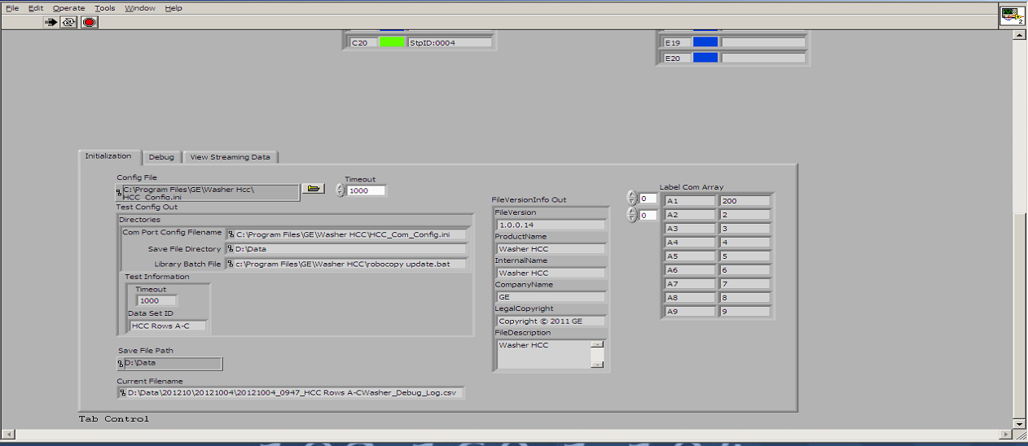
Important Files
Executable is c:\Program Files\GE\Washer Hcc\Washer HCC.exe
Shortcut is on desktop
Initialize tab shows important file names for initialization
C:\Program Files\GE\Washer Hcc\HCC_Config.ini holds config info.
From this file:
HCC_Com_Config.ini contains all of the com port definitions
D:\Data is the directory where the local copies of all of the data is stored
Every hour, robocopy update.bat is run. This batch file copies the local copy of the data to the NAS drive every hour.

Slide 6
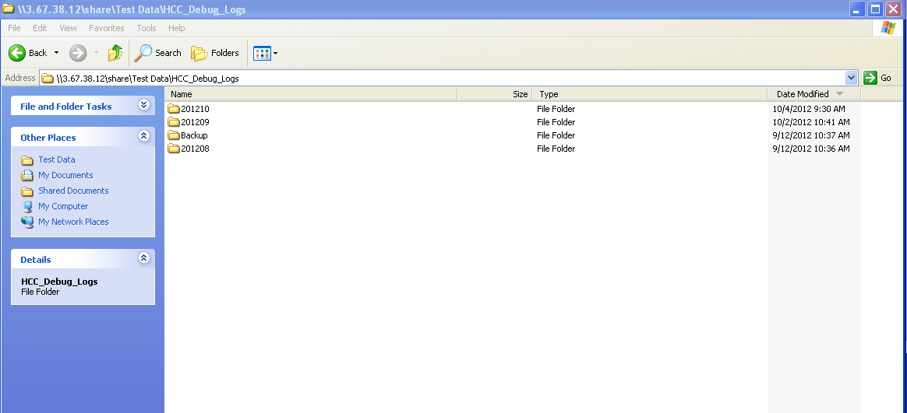
Data files: Debug Logs
Can be accessed from the GE side at:
Dir = \\3.67.38.12\share\Test Data\HCC_Debug_Logs
All data files stored by Dir\Month folder\Day folder\Hour file.csv
Run Joe Rheas macro on the relevant file when there is a “yellow” condition, and enter the result in a fracas.

Slide 7
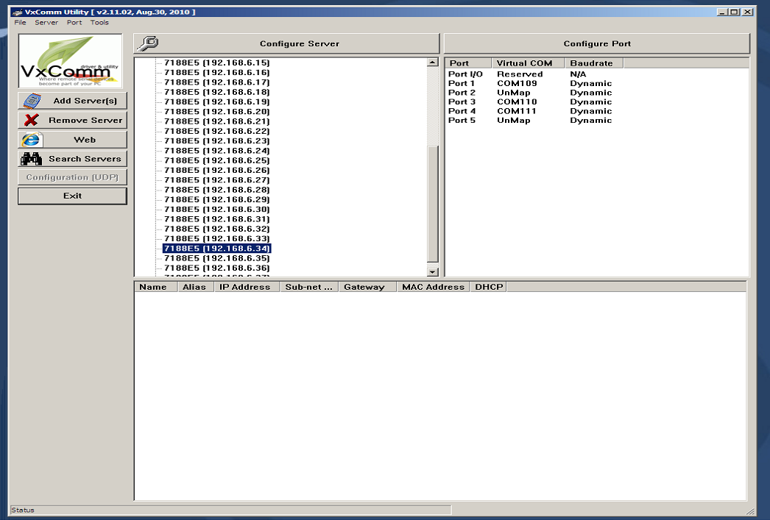
VxComm used to set up ICP7188e5 serial converters

